Slide 1
MapReduce, Hive, and Sqoop

Slide 2
MapReduce
The very first big data technique
Map – Turn only required data into key-value pairs
Reduce – Aggregate the keys

Slide 3
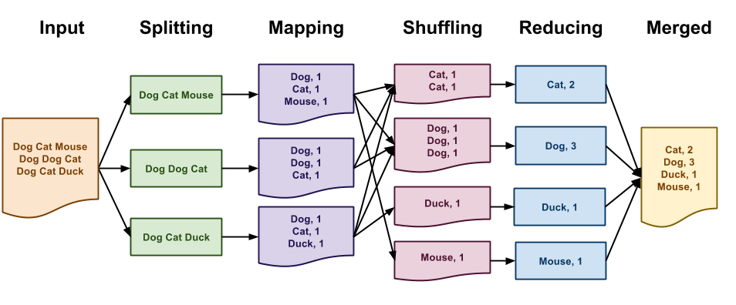
An Extended MapReduce Example

Slide 4
Modern MapReduce
Programs integrated the concepts
Hive
Spark
Pig

Slide 5
Hive
SQL queries on big data

Slide 6
Comparing Versions
MySQL
HiveQL
CRUD
View is a temporary table accessed later
Schema on write: structured data
No CRUD
View is a fleeting construct
Schema on read: unstructured data

Slide 7
Sqoop
SQL + Hadoop
Run queries in MySQL on Hadoop

Slide 8
Questions?

